Slide 1

Customer Shopping Behavior Analysis
3,900 purchases — goal: uncover spending, segments, preferences, subscriptions

Slide 2
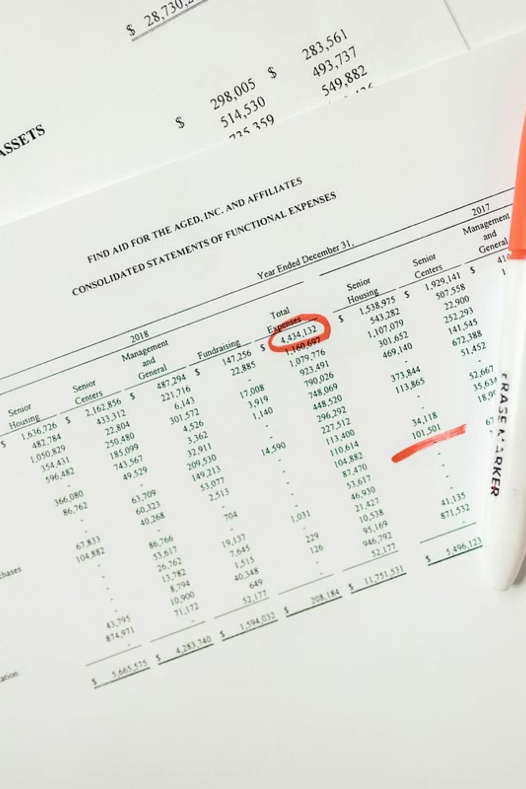
Dataset Summary
Scope
Key features
Rows: 3,900 · Columns: 18
Demographics, purchase details, behavior, shipping, discounts
Missing data
37 values in Review Rating

Slide 3

Exploratory Data Analysis (Python)
01
Load & Inspect
pandas: df.info(), df.describe()
02
Missing values
Imputed Review Rating by category median
03
Standardize & Engineer
snake_case columns, age_group, purchase_frequency_days
04
DB Integration
Loaded cleaned DF into PostgreSQL

Slide 4

Revenue by Gender
Male: 157,890 · Female: 75,191
Clear revenue skew toward male customers

Slide 5

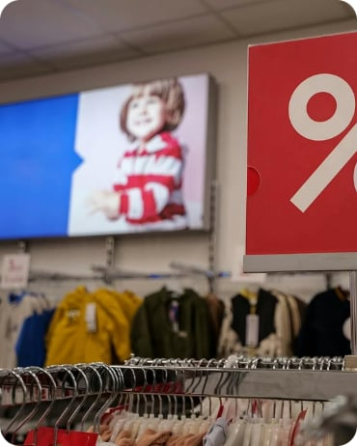
Discounts & High-Spending Users
High-spending discount users
Top discount-dependent products
839 rows identified — customers using discounts but spending above average
Hat 50% · Sneakers 49.66% · Coat 49.07% · Sweater 48.17% · Pants 47.37%

Slide 6
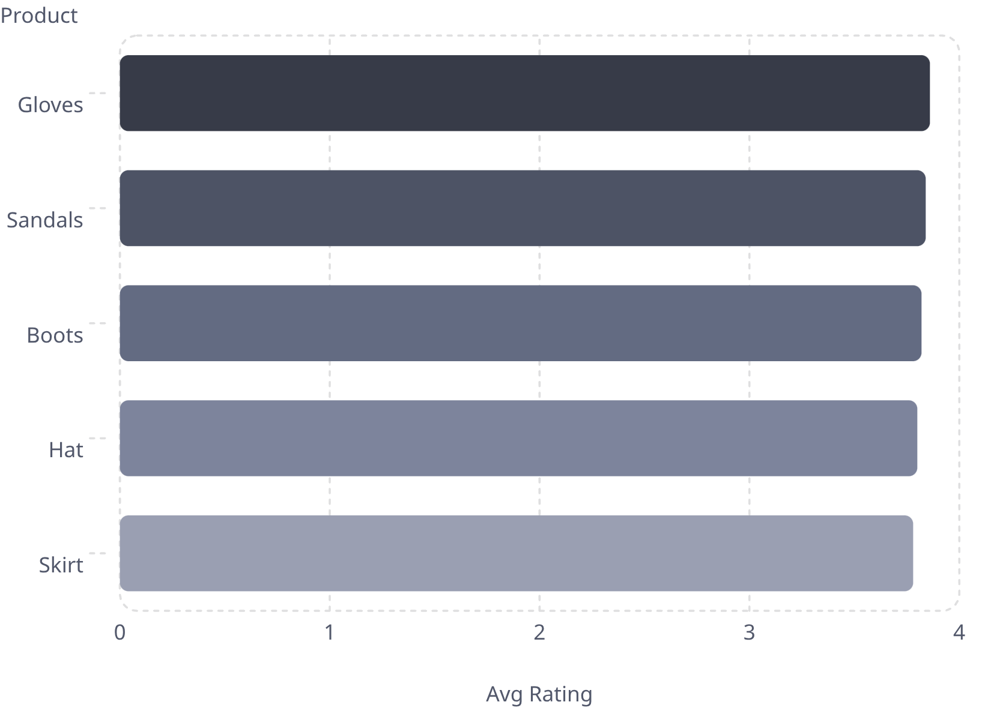

Top Products by Rating
Use high-rated items for product positioning and campaigns
Leverage Gloves, Sandals, Boots in promotions

Slide 7
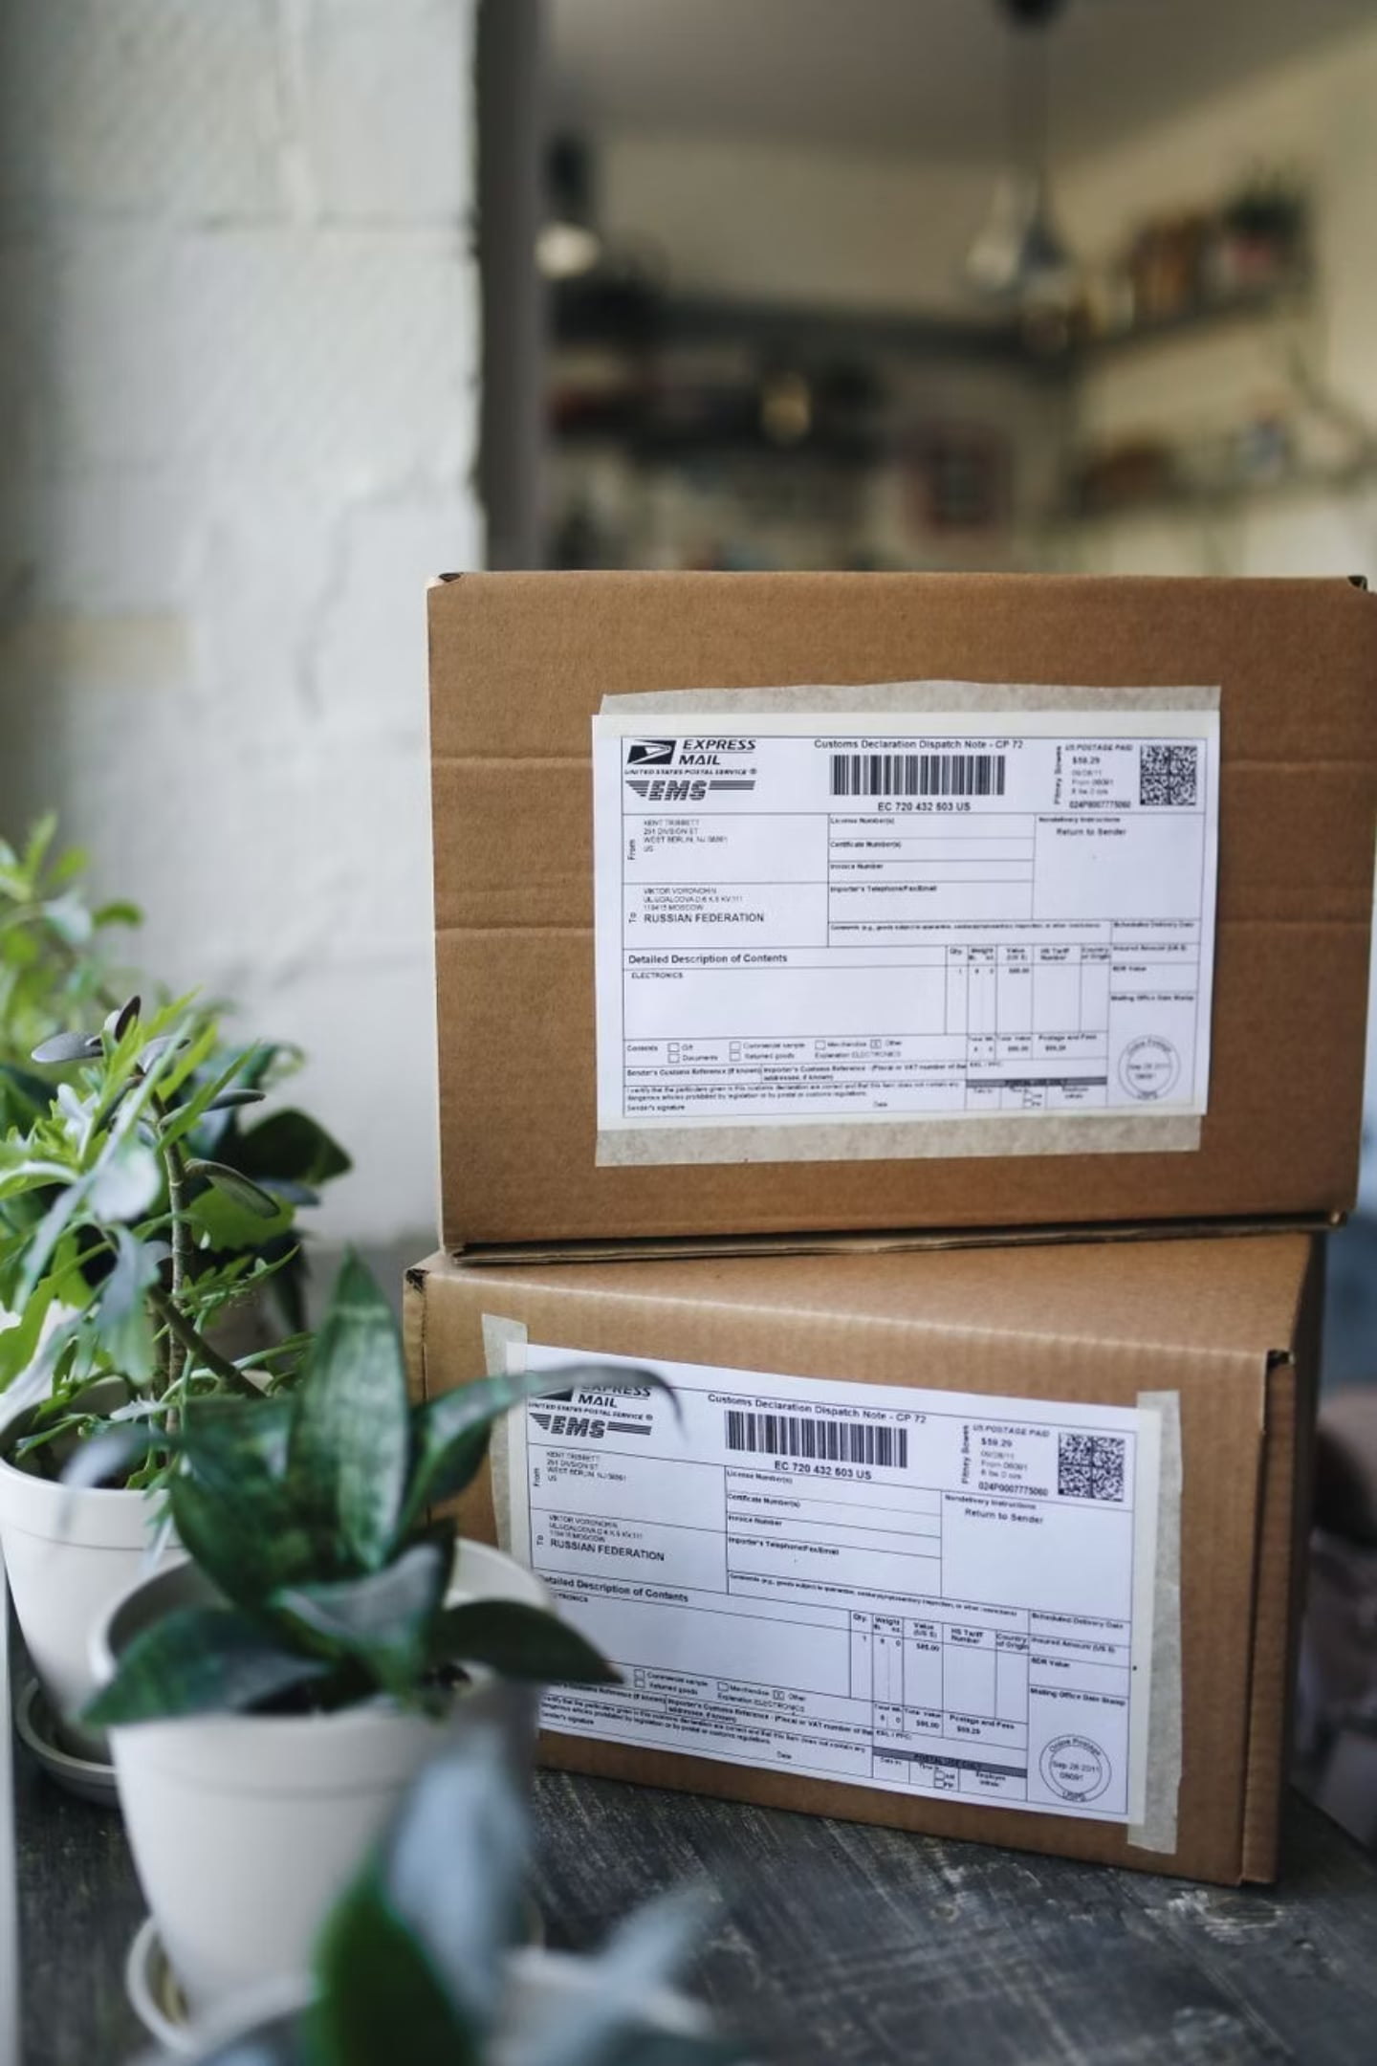
Shipping & Subscription Insights
Shipping
Subscribers
Standard avg: $58.46 · Express avg: $60.48
Yes: 1,053 customers · Avg spend $59.49 · Total revenue $62,645
Non-subscribers
No: 2,847 customers · Avg spend $59.87 · Total revenue $170,436

Slide 8




Customer Segmentation
Loyal
3,116 customers
New
83 customers
Returning
701 customers
Repeat buyers (>5 purchases) more likely to subscribe: Yes 958 · No 2,518

Slide 9
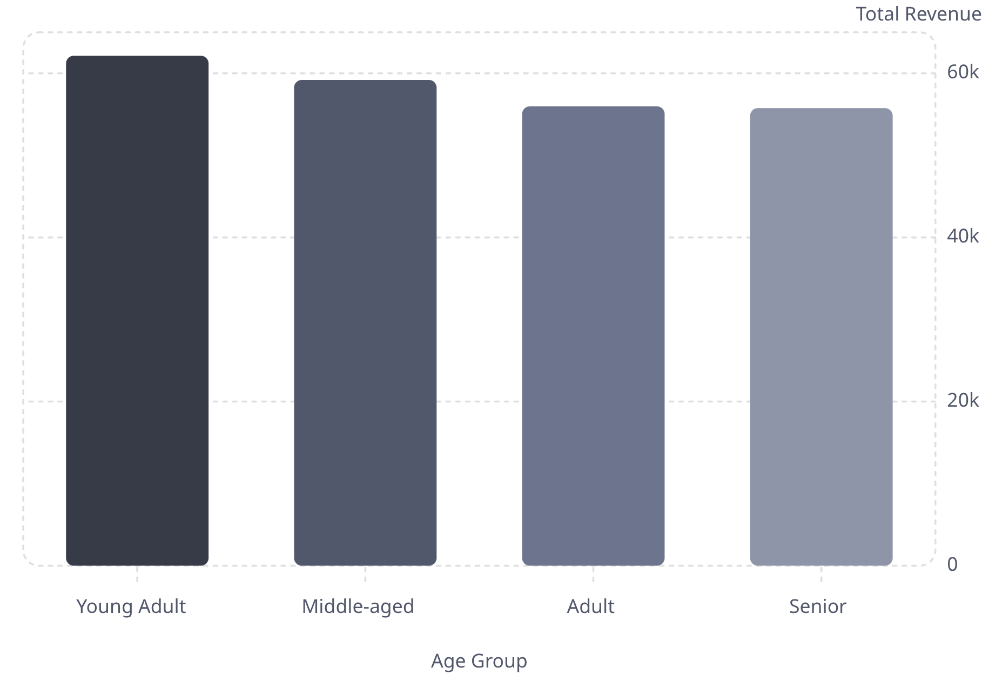

Revenue by Age Group
Prioritize marketing toward Young Adults and Middle-aged segments

Slide 10

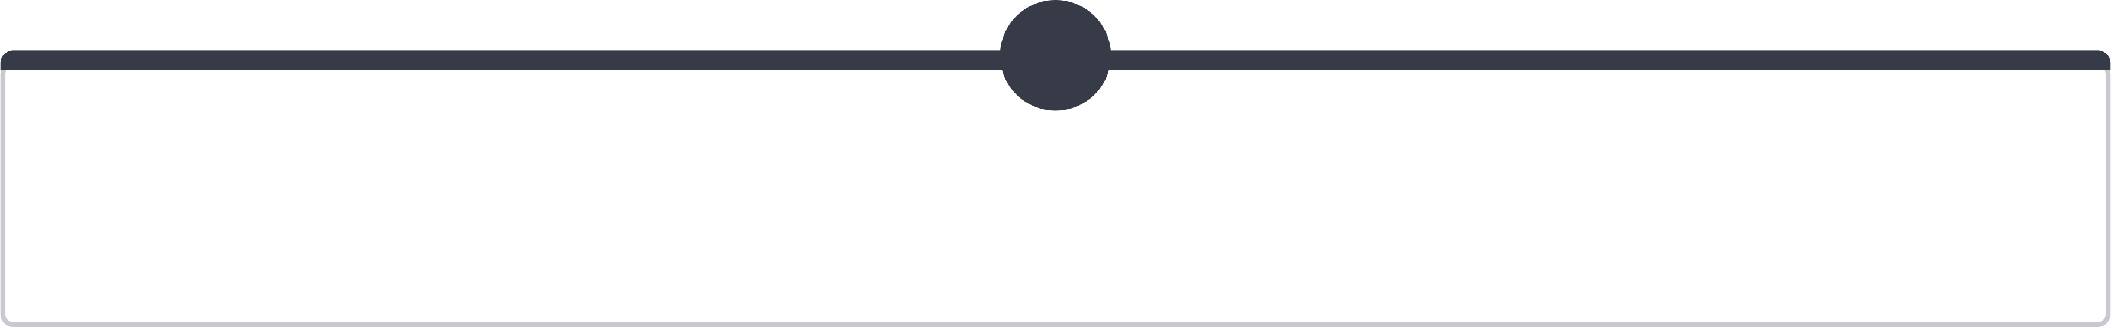
Business Recommendations
1
2
3
4
Boost Subscriptions
Loyalty Programs
Review Discount Policy
Product Positioning
Reward repeat buyers to increase loyalty
Promote exclusive subscriber benefits
Balance sales uplift with margin control
Highlight top-rated and best-selling items
5
Targeted Marketing
Focus on high-revenue age groups and express-shipping users

